Slide 1
Underline
1: Needfinding
Title: Art Expo
Team: Aditya, Shreya, Saurav,Smrithi

Slide 2

Needfinding Methodology
1
The methods used by us are :
Audio/Video Interviews
Digital Surveys
Observations

Slide 3
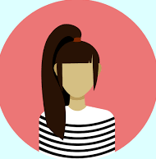
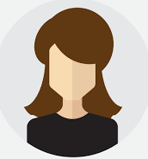

Interviewee Recruitment
We recruited our interviewee’s based on their background and experience with respect to art and business.
Our participants were ranging from students to working professionals, who used social media websites during large parts of their day.
We tried to find a diverse range of participants who sell and view art as a form of relaxation, to people who are not that keen on art.
Notes:
Our interviewees

Slide 4
INTERVIEWEE - 1
Mahah Sadique
A budding engineer who is the owner and operator of the popular polymer clay modelling store - ‘madebymahah’, which receives multiple orders monthly. She is quickly becoming a revered small business owner in her field.
She uses Instagram and interacts directly with customers to negotiate and receive orders.
Notes:
Our interviewees

Slide 5
Question-1
“ It started off as a hobby, which then blossomed into a small business in the lockdown. I found that its very rewarding, and enjoyed building the brand. I also found that working on my craft was very therapeutic for me, and also provided a source of income.”
“I found that many customers wanted custom orders, apart from the things I already displayed, and wanted to give the brand and each of the pieces a personal touch.”
Where did your journey begin?
1

Slide 6
Question-2
“ I have been using Instagram to conduct and promote my business.
I like that the interaction with potential customers is more organic because we can chat and negotiate prices directly. Also, as Instagram doesn’t charge any money for creating a business account and for promotions, it's easier to reach a larger audience, without having to take a cut on profits like other platforms. I also get to keep the copyrights to all my work
As everything happens over text, all the data is disorganised and there is no central dashboard to organise orders.”
Which platform have you been using to showcase your work? What do you like and dislike about it?
2

Slide 7
Question-3
“ I find that its not that it's not very useful for conducting business as I like to keep things uniform while interacting with customers.
I sometimes use it on my personal account, but don’t really like it.”
What are your thoughts on any platform’s theme customisation?
3
Notes:
.

Slide 8
Question-4
“I would like to see some accessibility features so that the site can be accessible to a wonder range of audience which will be good for businesses.
I think dedicated UI for a nice experience will be welcoming to everyone.”
What would you like to see different in a new platform?
4

Slide 9

INTERVIEWEE - 2
Aditi HD
An aspiring modern-day fashion blogger who creates content on various platforms showcasing her art. She is a fashion designer in the making, who also makes customized portraits of people during her time off. She has sold many pieces through instagram and hopes to pursue her career in the fields of art.
Notes:
Our interviewees

Slide 10
Question-1
“ My journey with Social media started right after I turned 18. I always had an interest to learn different techniques in drawing, so i spent my days drawing face portraits of celebrities and friends. This hobby soon turned into a small business. I made customised gifts for people on instagram and decided to make reels to promote my work. I loved making my own pocket-money and the validation made me feel good about myself. People liking what i made, made me more confident to post more and explore in different fields”
How has your journey been with social-media so far?
1

Slide 11
Question-2
“Soon i realised that instagram did not help people with less followers and I could not monetise on it. There were not many people who wanted to buy from someone who was just starting out. It was an extremely toxic environment and did not have many positives by the end of it
”
Why did you stop using social media to sell your art?
2

Slide 12
Question-3
“I have always been a very shy person so for me to start showcasing my art took a while, as I mentioned earlier all social media websites have their own pros and cons. I was afraid of what people I know would think. I was criticised by my relatives for making content which they did not approve of so I think before I started I would have loved it if there was a platform where i could use a stage name rather than my own name”
Has anonymity been an important aspect of your journey?
3

Slide 13
Question-4
“Especially now during pandemic i realised that I am an extremely anxious person, I was diagnosed with hypochondria. It was particularly hard for me during this period to deal with
Due to my hobby I found a distraction that helped me think less about covid, it was so hard for me to deliver paintings but it was also my constant source of income. Since instagram did not have a delivery service available it was hard to transport everything on time”
What stresses you out the most?
4

Slide 14
INTERVIEWEE - 3
Swetha Krishna
A gifted artist with ample knowledge in various forms of art, she is not professionally trained but has been doing art all her life. She loves photography, music, painting and drawing. She likes to create pieces that are unique yet inspiring. She has completed various courses online and has a dedicated page for her art on social media platforms.
Notes:
Our interviewees

Slide 15
Question-1
“ Growing up I was always into music, painting, drawing. I loved the feeling of creating my own paintings, it was a gratifying experience for me. I simply enjoyed playing with colors hanging them in my room. It's been a hobby of mine since when I was a child.”
What does art mean to you?
1

Slide 16
Question-2
“”Art for me is a hobby so as long as I don't have the pressure of creating more in my free time, I'm open to the prospect of selling my art. It is a gratifying experience to share what I've made, it's really nice to hear that someone would buy it”
Would you like to sell art online?
2

Slide 17
Question-3
“ I use art for everything. It's the first thing I do when I'm stressed or when i am happy . I spend time listening to music or taking pictures of birds around my house. It always calms me and makes me go about my day better”
How has art helped you?
3

Slide 18
INTERVIEWEE - 4
Karthik Surya
An engineer in the making, generally anxious about his coursework. With the pandemic, the mediums used for educational purposes have been changed to make it more convenient to the current situation.
During these tough times he's finding it difficult to balance his work and life
He does not create art but has an avid interest in all forms of art and finds comfort in it during these tough times.
Notes:
Our interviewees

Slide 19
Question-1
“ Honestly, when I am stressed I just watch a video or two of my favorite content creator and feel a lot better and go about my day. ”
What do you do when you are stressed?
1

Slide 20
Question-2
“ I almost use my phone all day from the time I wake up, until I go to bed. Due to pandemic it's one of the most vital things in my life to keep me posted about my work regarding school. Everything now has changed into an online interface it gets quite monotone using the same apps with the same features/tones everyday”
How long do you think you use your phone?
2

Slide 21
Question-3
“I prefer the darker tonnes, the black, blue and the greys. My closet is filled with them. “
“I love colors when it comes to my gaming resolutions. The colors are always a plus even though it is limited”
“My phone usually has the default dark mode switched on where the it changes the colors to the dark mode automatically. It is primarily because I feel white mode uses up a lot of my battery.”
What the tones of colors do you prefer to use in your everyday life and why?
3

Slide 22
Question-4
“For someone who can't create art I learn everything through art. I can't study or focus without text highlighted in different colors. I have always been known for having a good memory power and the secret to.that is again pictorial representation of the concept in my mind lt. I map concepts and make stories and it always helps me retain everything as accurately as possible “
How is your learning process?
4

Slide 23
Question-5
“ Art can be anything that's created by humans, it is diverse in its form and it can take various shapes and forms. Art simply to me is like solace. I don't have words to articulate my thoughts but it's anything that moves and helps me make my day better. It is what stays with me when I'm happy, sad, stressed. I listen to music when I'm sad. I watch movies when I'm happy. Art is a vital source of shaping an individual. That's art to me. ”
What is art to you?
5

Slide 24
Interviewee-5
Deepank
He is an art enthusiast, whose life revolves around art. He is an avid collector of exquisite paintings from different regions of the country. He loves traveling and brings back pieces from each destination.
He's not much of a creator himself but loves to live life amidst art.

Slide 25
Question-1
“ In my day to day it's really hard for me to go about my day with no hassle. I can't really make out colours in the signal, I can't find out if the banana is ripe or not. I can't make out the difference between colors in a rubix cube. Everything is hard but I'm used to it now.”
How hard is it to go about your day with colour blindness?
1

Slide 26
Question-2
“ It is a bit confusing at times, because usually, UI is not made keeping the color blind community in mind. So a lot of times, I need some assistance from friends or family while navigating complex sites, or finding something to buy, etc. Earlier I used to get confused between some of the colors in some websites, but I’ve kind of gotten used to it now.”
How hard is it to navigate websites generally?
2

Slide 27
Analysis
3

Slide 28
Effects of Art Therapy
The American Art Therapy Association states that art therapy can be an effective mental health treatment for individuals who have experienced depression, trauma, medical illness, and social difficulties. Making art in therapy can be a way to achieve personal insight as well as healing.

Slide 29
Color Theory
We live in a world of color. According to the various researches, the color that surrounds us in our daily lives has a profound effect on our mood and on our behavior In clothing, interiors, landscape, and even natural light, a color can change our mood from sad to happy, from confusion to intelligence, from fear to confidence.

Slide 30
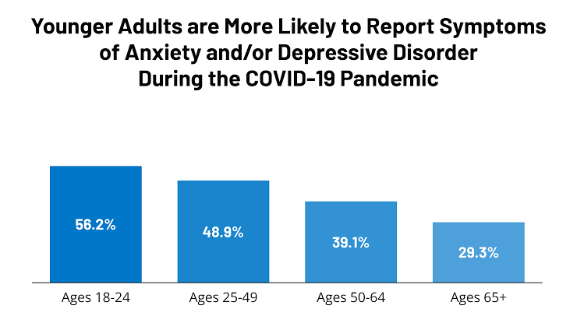
Stastics of Anxiety/Depression

Slide 31
Observation on colours
Monotonic colours don't excite or motivate people. Based on our research we have observed that a person wears bright tonnes/hues on a happy day. It keeps you motivated throughout the day.
We always associate a happy/bubbly person with bright colours.
.

Slide 32
People with color blindness
Insight: The color blind community has trouble navigating through UI generally.
Need: Creating a UI catered to them so they can navigate across the site easily and engage in business.

Slide 33
Art Therapy
Insight: A lot of people have developed anxiety disorders, and depression over the past year and seek comfort
Need: A platform that has a soothing UI and a feature to buy to buy/sell art can provide calming effects and boost self esteem

Slide 34
Assistance for people with Dyslexia
Insight: People with dyslexia would like to indulge in the art business, but current platforms don’t have accessibility features
Needs: Providing aids such as text to speech for all text content on the platform, as well as using universal symbols for navigation

Slide 35
Surveys Conducted

Slide 36
Survey-1 questions
Do you want a specific platform for buying/selling?
What are your apprehensions while buying art online?

Slide 37
Survey-1 questions
Are you an art enthusiast?
Have you tried to sell art online?
Would you prefer to remain anonymous while you post your art? (if applicable) *

Slide 38
Survey-2 Questions
Due to recent events, do you feel stressed or anxious a lot these days?
Do you suffer from any form of mental disability? If yes, give a description about it.

Slide 39
Survey-2 Questions
Do you find it difficult to navigate applications due to this disability? (Answer if applicable)
If yes to the above question.How hard is it to navigate on these sites?

Slide 40
Survey-2 Questions
Do you think an application with other forms of communication other than just text and pictures would be beneficial?

Slide 41
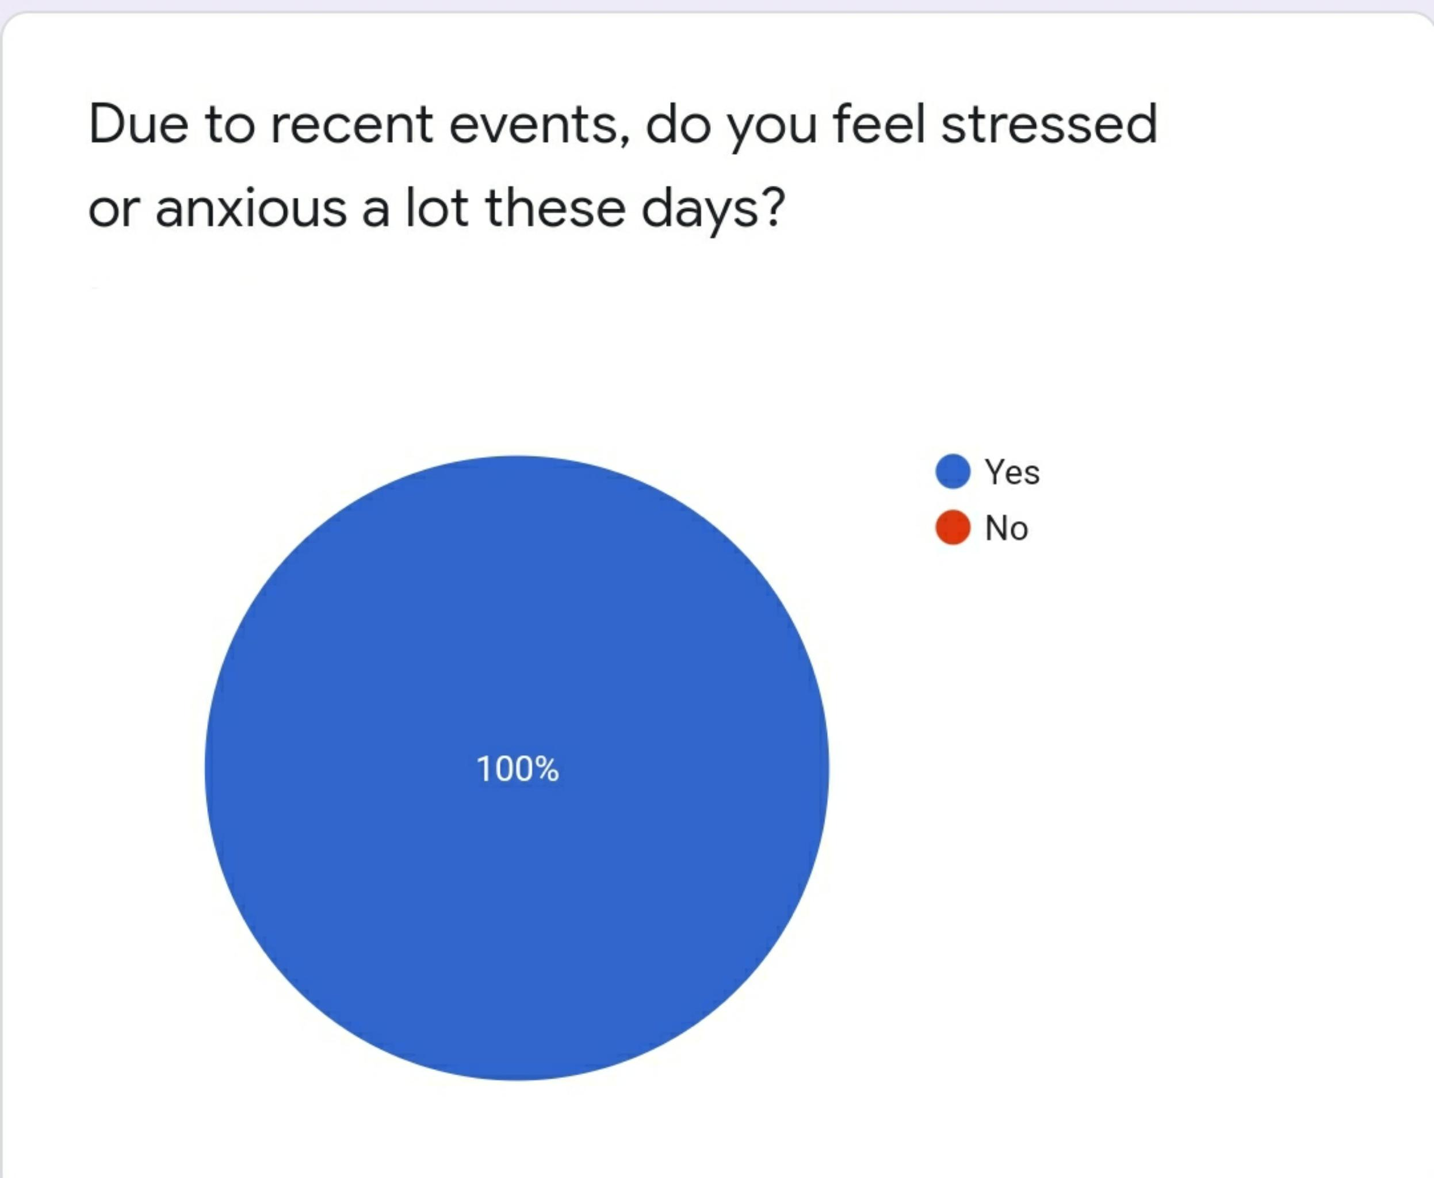
Observations

Slide 42
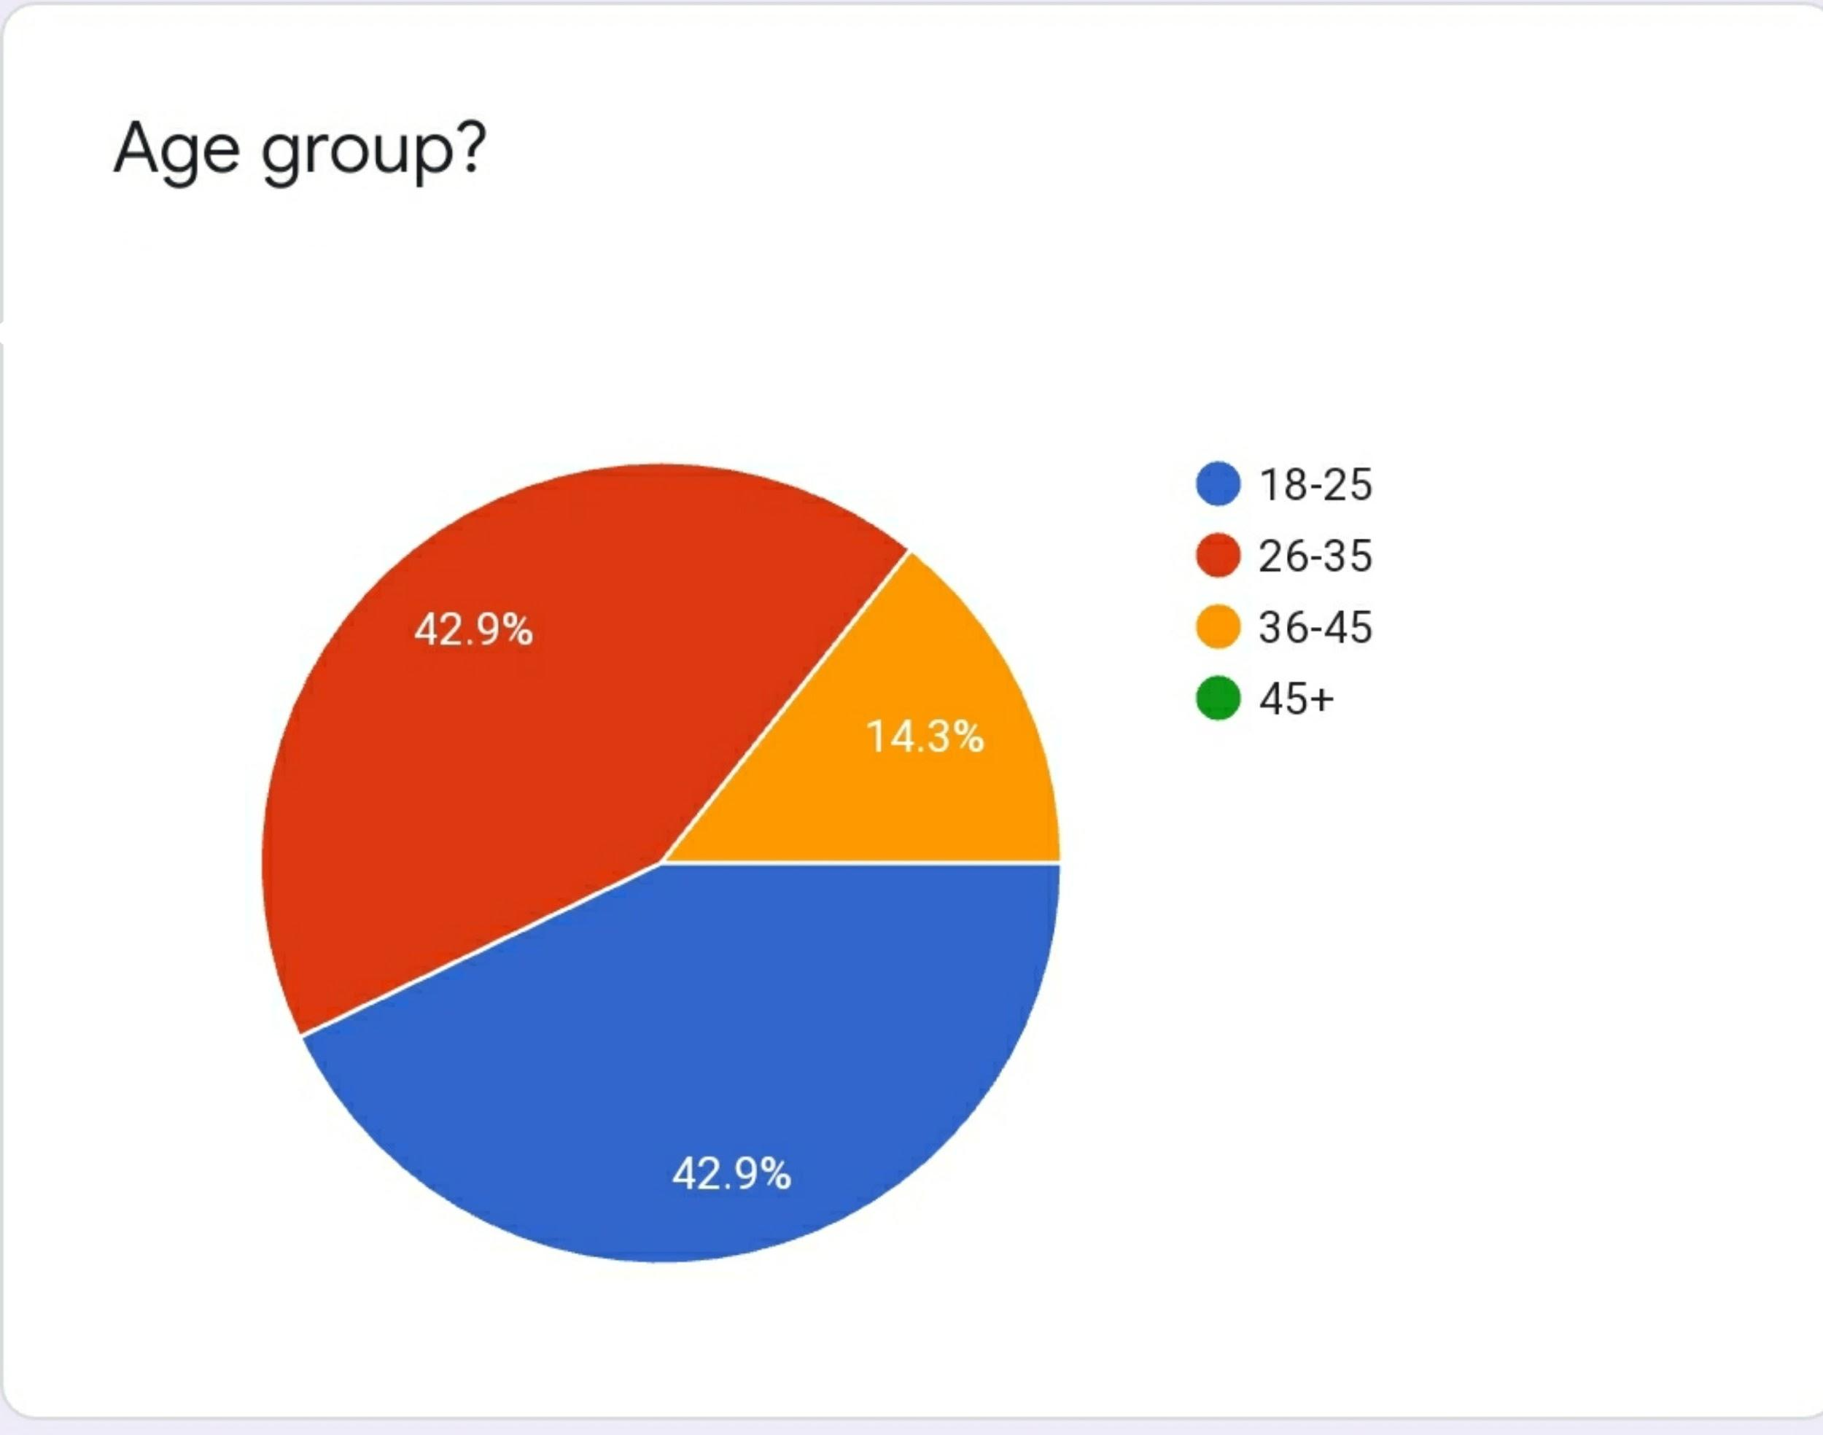
Observations

Slide 43
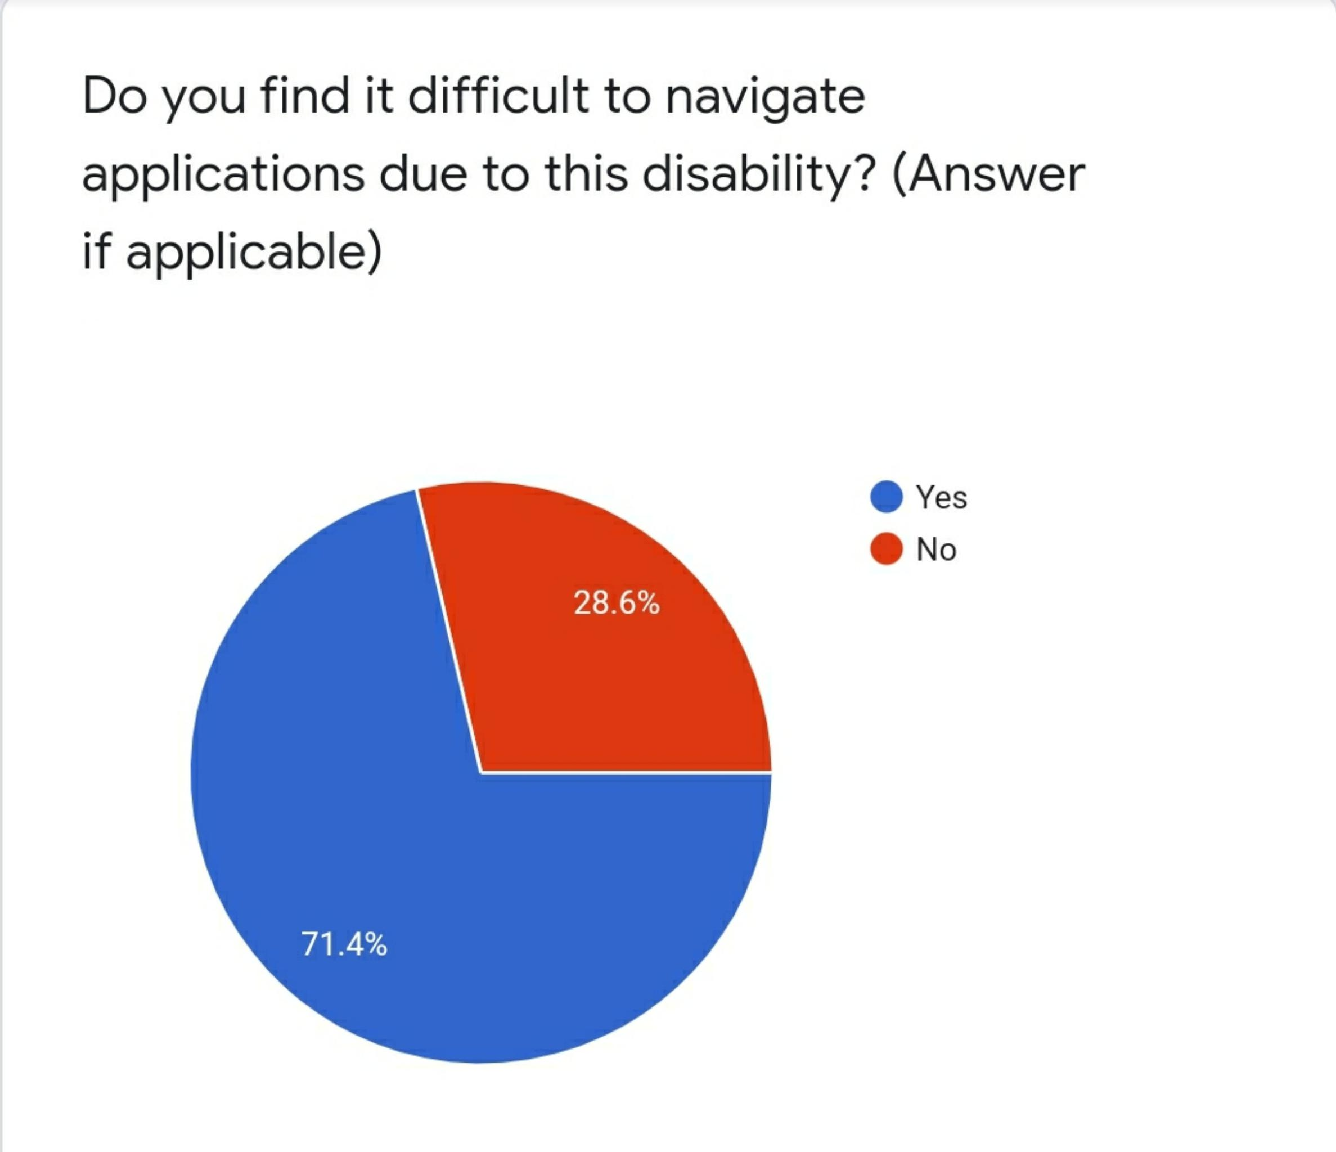
Observations

Slide 44
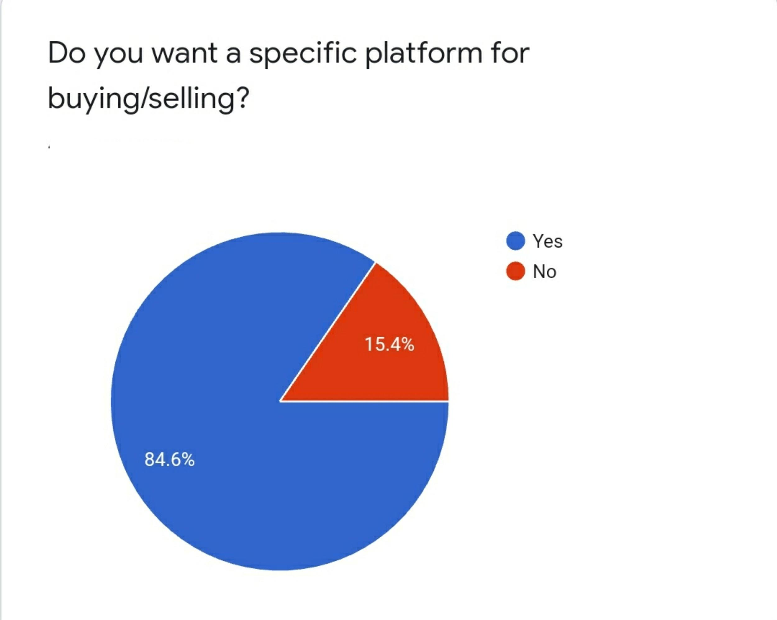
Observations

Slide 45
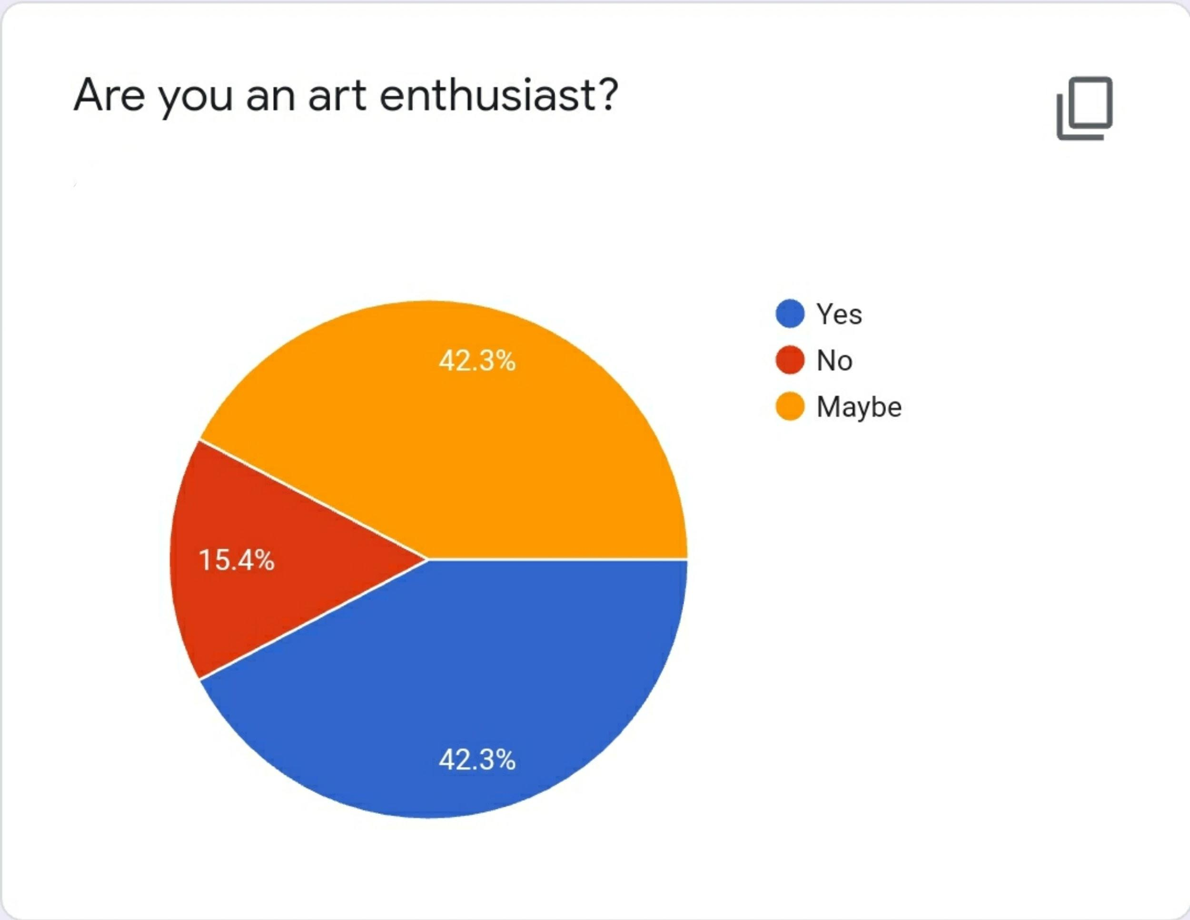
Observations

Slide 46
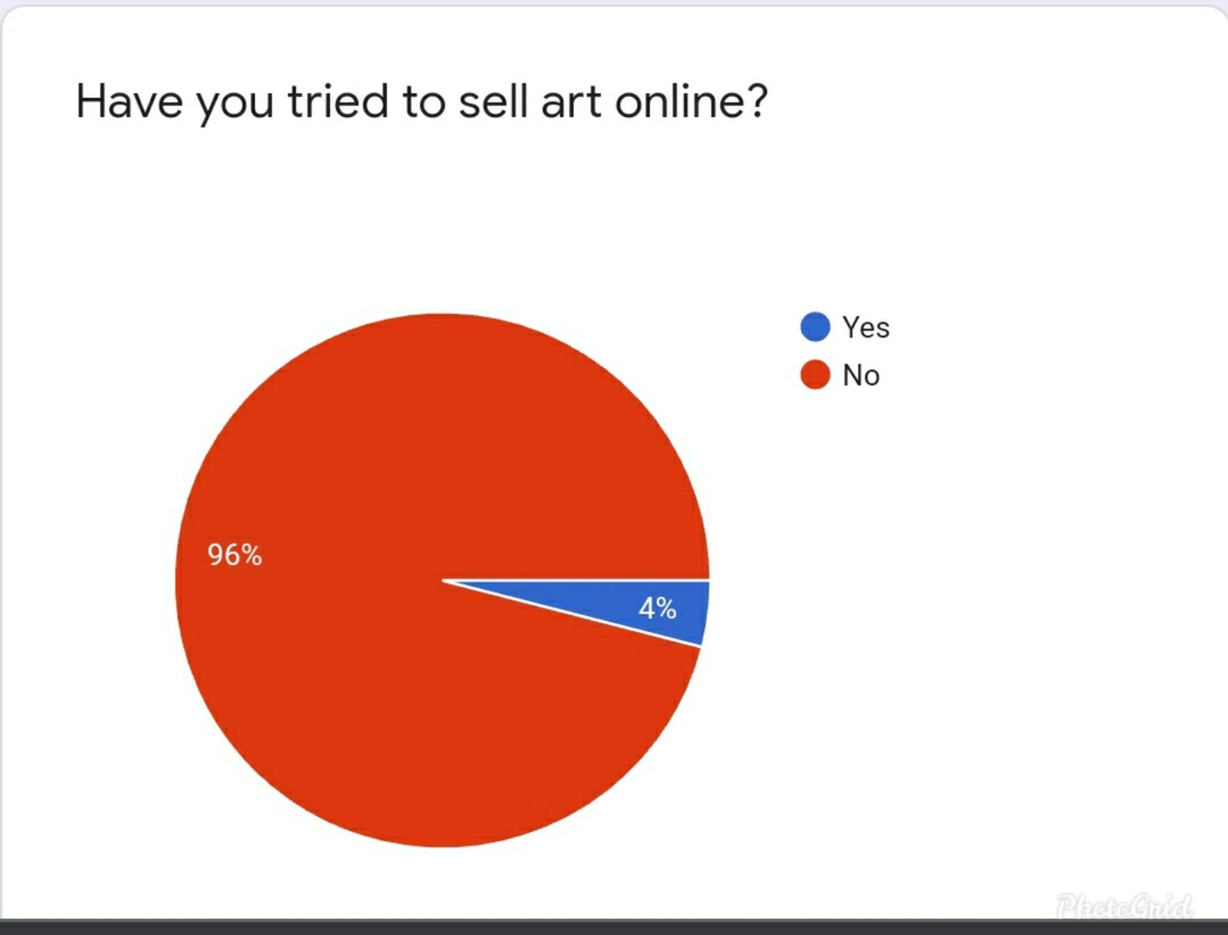
Observations

Slide 47
Summary
During these tough times there has been an increase in mental health issues
We have observed through our surveys and interviews that people venture into art creation or buying/selling to understand their emotions and feel good about themselves

Slide 48
Summary
It has been observed that colors play a part in moods of an individual
There are not many websites that cater to people who deal with learning disability and color blindness

Slide 49
Thank you!

